Slide 1
Intermediate Coding Week 18
Objects and Lists

Slide 2

Objects

Slide 3
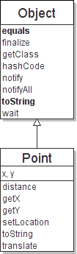
Class Object
All types of objects have a superclass named Object.
Every class implicitly extends Object
The Object class defines several methods:
public String toString() Returns a text representation of the object, often so that it can be printed.
public boolean equals(Object other) Compare the object to any other for equality. Returns true if the objects have equal state.

Slide 4
Object variables
You can store any object in a variable of type Object.
Object o1 = new Point(5, -3);
Object o2 = "hello there";
Object o3 = new Scanner(System.in);
An Object variable only knows how to do general things.
String s = o1.toString(); // ok
int len = o2.length(); // error
String line = o3.nextLine(); // error
You can write methods that accept an Object parameter.
public void checkForNull(Object o) {
if (o == null) {
throw new IllegalArgumentException();
}
}

Slide 5
Comparing objects
...
x | 5 | y | 3
p1
...
p2
x | 5 | y | 3
The == operator does not work well with objects.
== compares references to objects, not their state.
It only produces true when you compare an object to itself.
Point p1 = new Point(5, 3);
Point p2 = new Point(5, 3);
if (p1 == p2) { // false
System.out.println("equal");
}

Slide 6
The equals method
The equals method compares the state of objects.
if (str1.equals(str2)) {
System.out.println("the strings are equal");
}
But if you write a class, its equals method behaves like ==
if (p1.equals(p2)) { // false :-(
System.out.println("equal");
}
This is the behavior we inherit from class Object.
Java doesn't understand how to compare Points by default.

Slide 7
Flawed equals method
We can change this behavior by writing an equals method.
Ours will override the default behavior from class Object.
The method should compare the state of the two objects and return true if they have the same x/y position.
A flawed implementation:
public boolean equals(Point other) {
if (x == other.x && y == other.y) {
return true;
} else {
return false;
}
}

Slide 8
Flaws in our method
The body can be shortened to the following:
return x == other.x && y == other.y;
It should be legal to compare a Point to any object (not just other Points):
// this should be allowed
Point p = new Point(7, 2);
if (p.equals("hello")) { // false
...
equals should always return false if a non-Point is passed.

Slide 9
equals and Object
public boolean equals(Object name) {
statement(s) that return a boolean value ;
}
The parameter to equals must be of type Object.
Object is a general type that can match any object.
Having an Object parameter means any object can be passed.
If we don't know what type it is, how can we compare it?

Slide 10
Another flawed version
Another flawed equals implementation:
public boolean equals(Object o) {
return x == o.x && y == o.y;
}
It does not compile:
Point.java:36: cannot find symbol
symbol : variable x
location: class java.lang.Object
return x == o.x && y == o.y;
^
The compiler is saying, "o could be any object. Not every object has an x field."

Slide 11
Type-casting objects
Solution: Type-cast the object parameter to a Point.
public boolean equals(Object o) {
Point other = (Point) o;
return x == other.x && y == other.y;
}
Casting objects is different than casting primitives.
Really casting an Object reference into a Point reference.
Doesn't actually change the object that was passed.
Tells the compiler to assume that o refers to a Point object.

Slide 12
Casting objects diagram
Client code:
Point p1 = new Point(5, 3);
Point p2 = new Point(5, 3);
if (p1.equals(p2)) {
System.out.println("equal");
}
public boolean equals(Object o) {
Point other = (Point) o;
return x == other.x && y == other.y;
}
x | 5 | y | 3
o
other
p1
p2
...
x | 5 | y | 3

Slide 13
Comparing different types
Point p = new Point(7, 2);
if (p.equals("hello")) { // should be false
...
}
Currently our method crashes on the above code:
Exception in thread "main"
java.lang.ClassCastException: java.lang.String
at Point.equals(Point.java:25)
at PointMain.main(PointMain.java:25)
The culprit is the line with the type-cast:
public boolean equals(Object o) {
Point other = (Point) o;

Slide 14
The instanceof keyword
if (variable instanceof type) {
statement(s);
}
Asks if a variable refers to an object of a given type.
Used as a boolean test.
String s = "hello";
Point p = new Point();
expression | result
s instanceof Point | false
s instanceof String | true
p instanceof Point | true
p instanceof String | false
p instanceof Object | true
s instanceof Object | true
null instanceof String | false
null instanceof Object | false

Slide 15
Final equals method
// Returns whether o refers to a Point object with
// the same (x, y) coordinates as this Point.
public boolean equals(Object o) {
if (o instanceof Point) {
// o is a Point; cast and compare it
Point other = (Point) o;
return x == other.x && y == other.y;
} else {
// o is not a Point; cannot be equal
return false;
}
}

Slide 16

ArrayLists
Notes:
Skip if it’s already past 4:35.

Slide 17
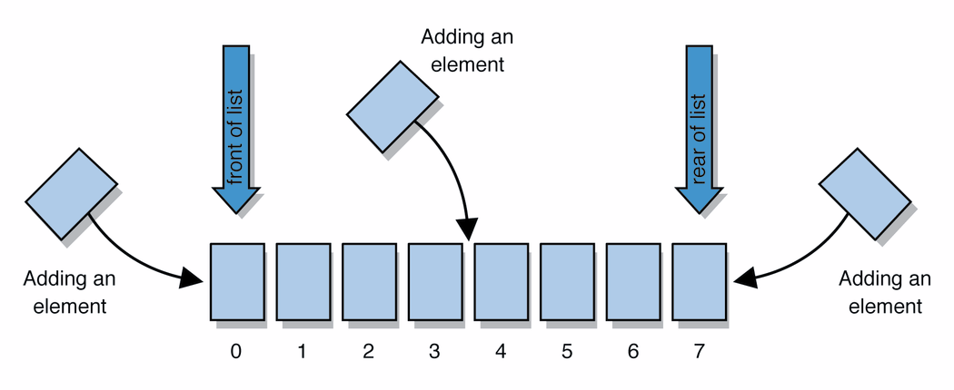
Lists
list: a collection storing an ordered sequence of elements
each element is accessible by a 0-based index
a list has a size (number of elements that have been added)
elements can be added to the front, back, or elsewhere
in Java, a list can be represented as an ArrayList object
Notes:
use jGRASP/DrJava Interactions window to create a list and add some elements, get them, check size

Slide 18
Idea of a list
Rather than creating an array of boxes, create an object that represents a "list" of items. (initially an empty list.)
[]
You can add items to the list.
The default behavior is to add to the end of the list.
[hello, ABC, goodbye, okay]
The list object keeps track of the element values that have been added to it, their order, indexes, and its total size.
Think of an "array list" as an automatically resizing array.
Internally, the list is implemented using an array and a size field.

Slide 19
ArrayList methods
add(value) | appends value at end of list
add(index, value) | inserts given value just before the given index, shifting subsequent values to the right
clear() | removes all elements of the list
indexOf(value) | returns first index where given value is found in list (-1 if not found)
get(index) | returns the value at given index
remove(index) | removes/returns value at given index, shifting subsequent values to the left
set(index, value) | replaces value at given index with given value
size() | returns the number of elements in list
toString() | returns a string representation of the list such as "[3, 42, -7, 15]"

Slide 20

Problems

Slide 21
Question 1
Write an equals method for any of the classes you have written so far for previous practice problems!

Slide 22
Question 2
Write a toString method for any of the classes you have written so far for previous practice problems!

